Slide 1
Discussion
Pilots
Reducing invalid trials
Consult before Pre-reg
Changes of mind

Slide 2
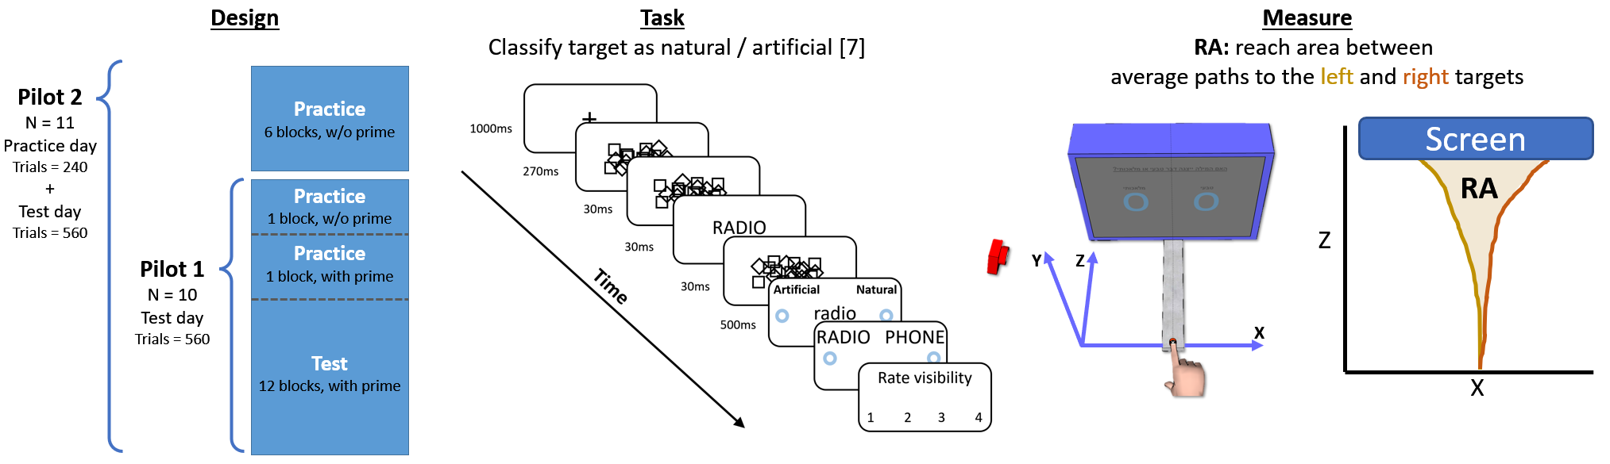
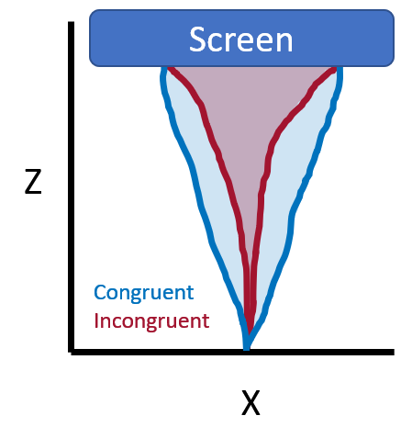
Pilot
Goal – Establish reaching as a valid measure for unconscious processing.
Notes:
Onset time > 100 ms
Reaction time < 320 ms
Movement time < 420 ms

Slide 3
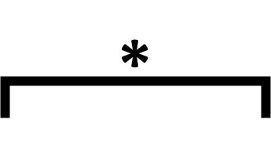
Pilot
Pilot 1 Pilot 2
Notes:
Onset time > 100 ms
Reaction time < 320 ms
Movement time < 420 ms

Slide 4
High volume of “bad” trials
Suggestions for reducing the volume?
Pilot 1
Pilot 2
Notes:
Onset time > 100 ms
Reaction time < 320 ms
Movement time < 420 ms

Slide 5
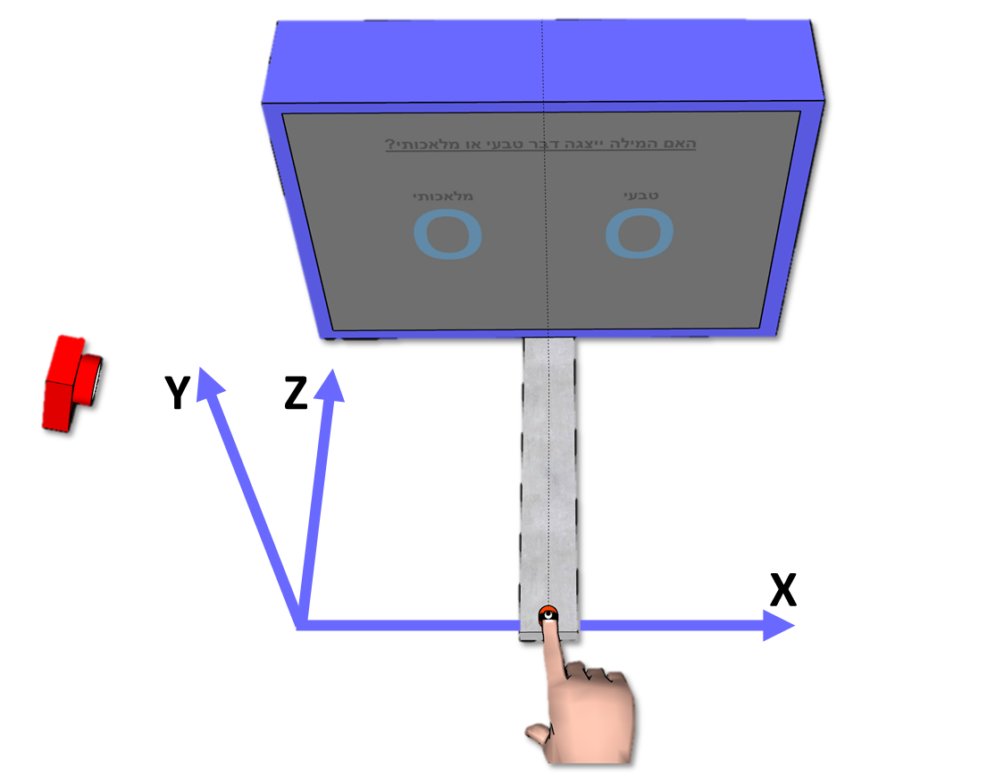
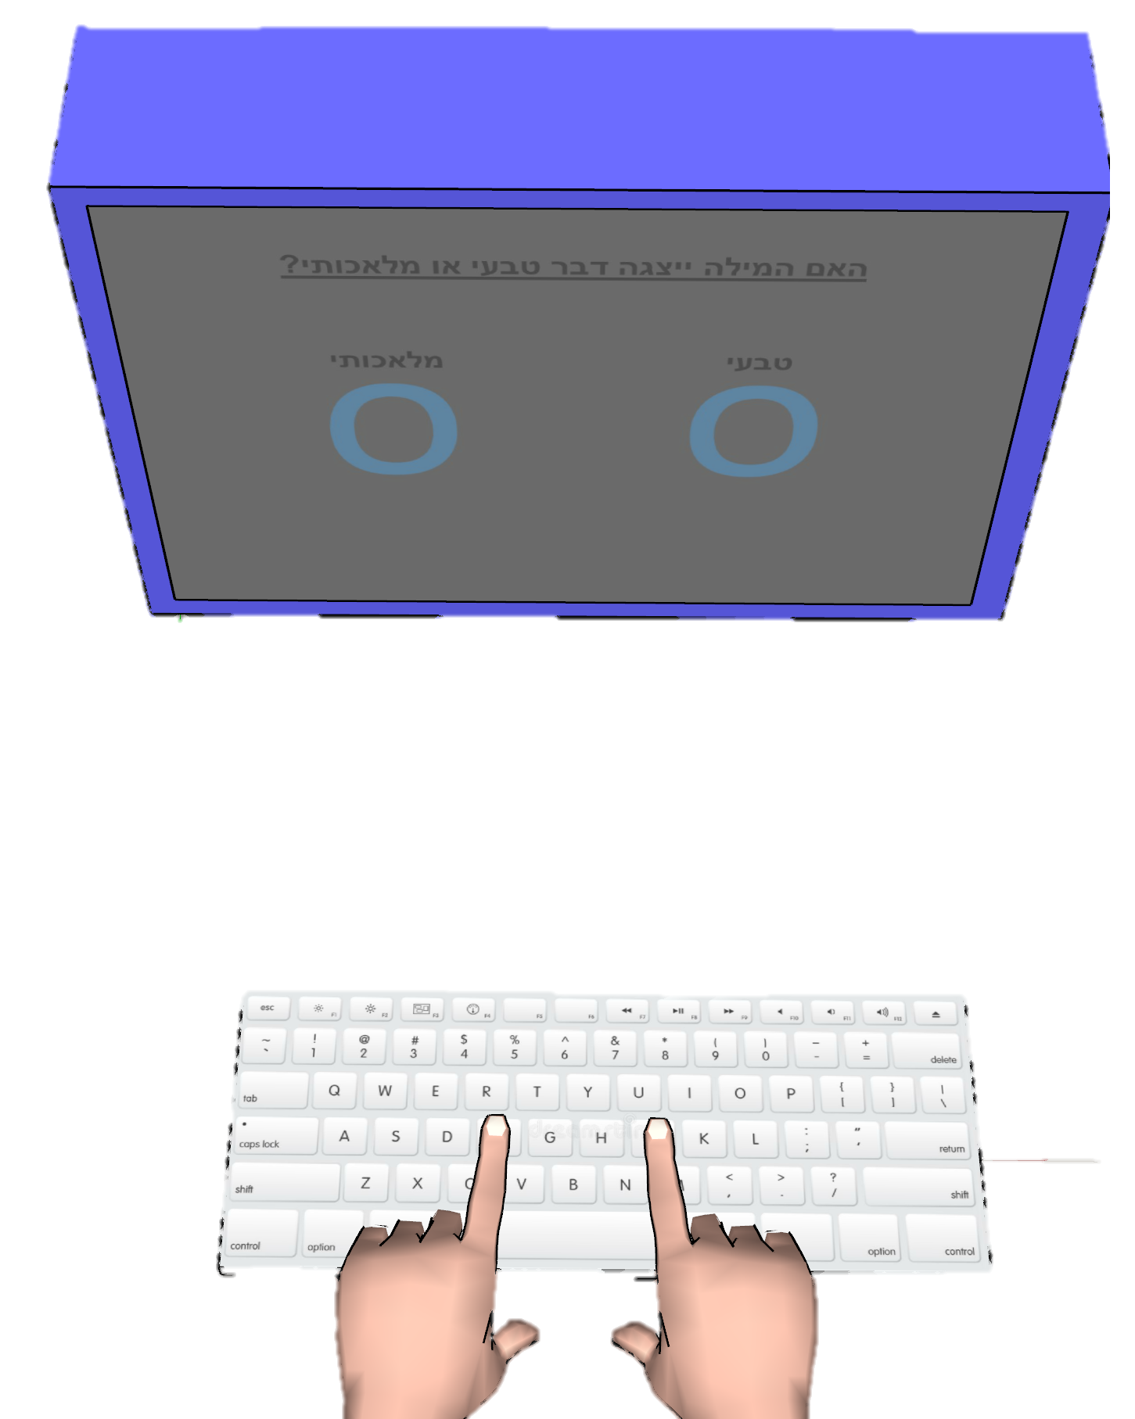
Pre-reg Experiment Design
Goal – Examine if reaching is a better than keyboard when measuring unconscious effects.
Design Measure Effect Size Comparison
Taken from previous studies and our pilot
2 groups:
1. Responds with a keyboard
2. Responds by reaching
Motion
Group
Keyboard
Group
Motion
Tracking
Max
Curvature
Stylus
Tracking
Max
Curvature
Motion
Tracking
RA
Mouse
Tracking
AUC
Motion
Tracking
RA
Keyboard
RT
Mouse
Tracking
AUC
[1] Xiao, K., Yamauchi, T., & Bowman, C. (2015). Assessing Masked Semantic Priming: Cursor Trajectory versus Response Time Measures. In CogSci.
[2] Almeida, J., Mahon, B. Z., Zapater-Raberov, V., Dziuba, A., Cabaço, T., Marques, J. F., & Caramazza, A. (2014). Grasping with the eyes: The role of elongation in visual recognition of manipulable objects. Cognitive, Affective, & Behavioral Neuroscience, 14(1), 319-335.
[3] Finkbeiner, M., Song, J. H., Nakayama, K., & Caramazza, A. (2008). Engaging the motor system with masked orthographic primes: A kinematic analysis. Visual cognition, 16(1), 11-22.

Slide 6
High volume of “bad” trials
Suggestions for reducing the volume?
Onset time > 100 ms
Reaction time < 320 ms
Movement time < 420 ms
Number of bad trials per subject
Pilot 2 Pilot 3

Slide 7
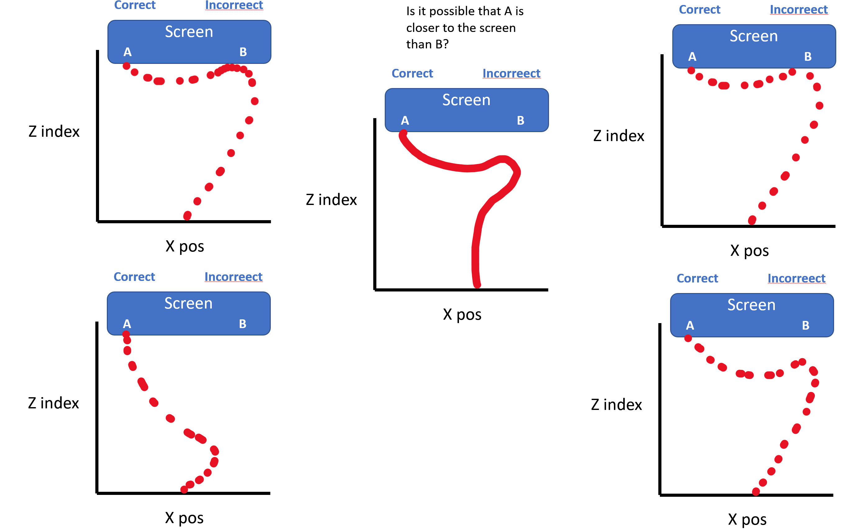
Changes of mind
Changes of mind Could occur at 4 timepoints:
Post hoc - A short delay after touching the screen.
On the fly - Immediately after touching the screen.
Prior - Just before touching the screen.
Early - Far from the screen.
Questions:
Caused by the prime?
Usually regarded as: “Slow movement”, “Incorrect answer”
What is the difference between 1-3?
Should they be treated differently?
Is (1) generated by a different motor plan?
Criterion for recognizing COM?
What will we benefit from recognizing COMs?
Can 1 and 2 be differentiated with a “hover threshold”
(Schmidt, T. (2002))?
Having multiple changes of mind in one reach is possible.
1) 2)
3) 4)
Notes:
Caused by the prime?
If so, we are loosing the effect of the prime, since we discard these trails due to slow movement or incorrect answer.

Slide 8
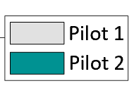
Changes of mind
Number of incorrect trials, some of which might qualify as changes of mind.
Percent of “Incorrect” trials out of valid trials:
Pilot 1 – 20%
Pilot 2 – 26%
(An incorrect trial cannot have any other reason for disqualification)
Pilot 1
Pilot 2

Slide 9
Screen
Screen
Screen
Z
Z
Z
Screen
Screen
Screen
Z
Z
Z
X
X
X

Slide 10
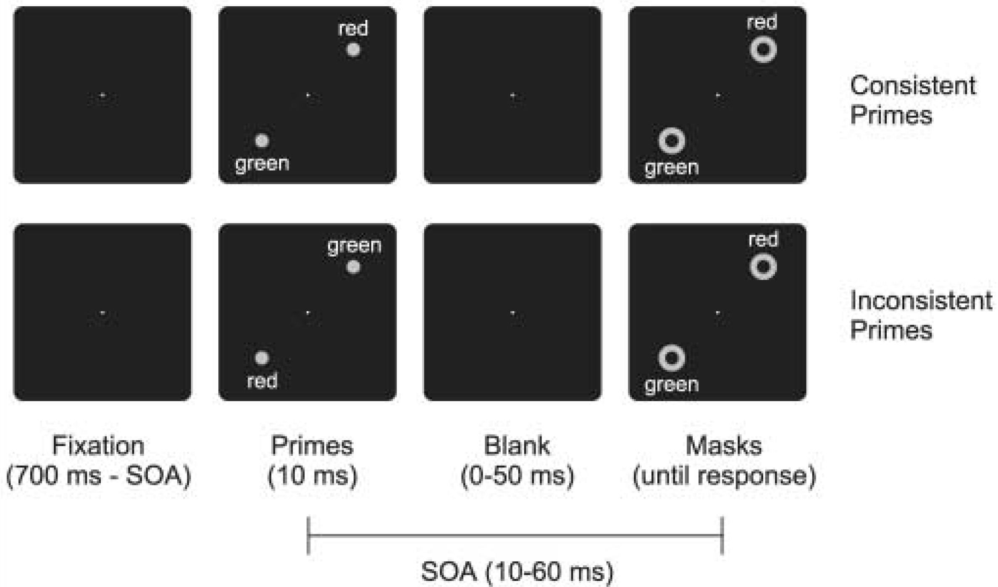
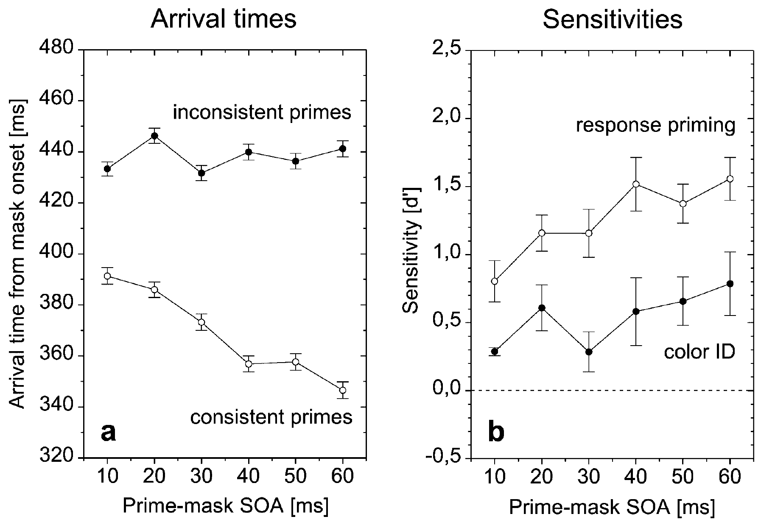
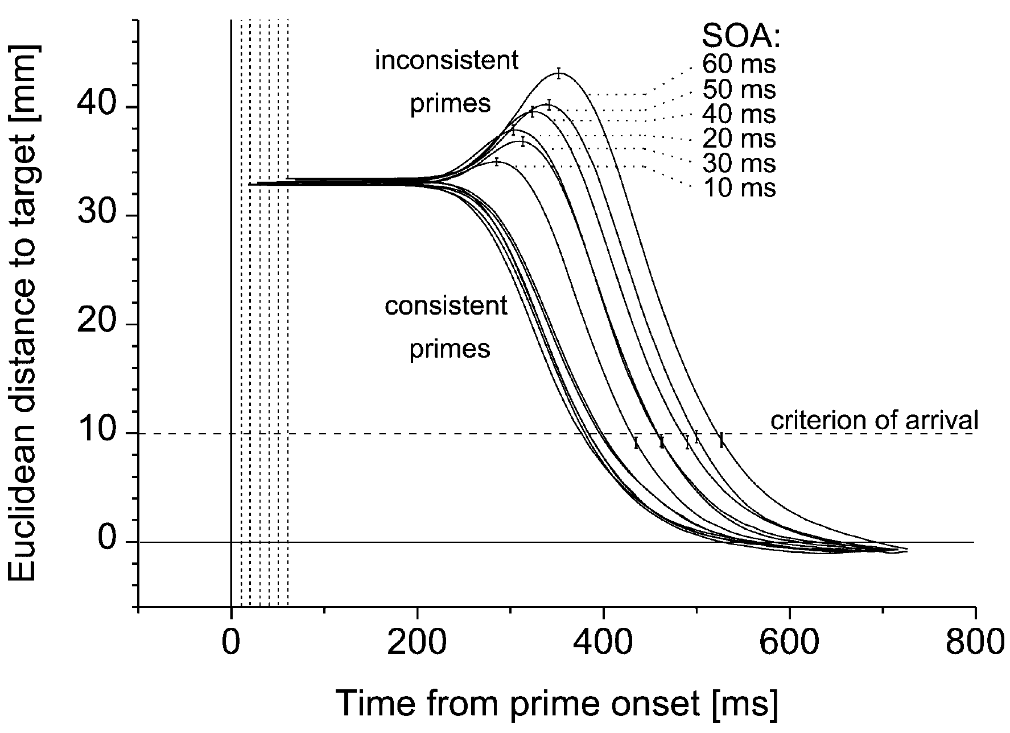
Schmidt, T. (2002) Exp 1
Tasks:
Mask ID – point to the red/green mask.
Response priming.
Color ID – point to the mask
preceded by a red/green prime.
Prime awareness.
“Hover threshold” = 334ms

Slide 11
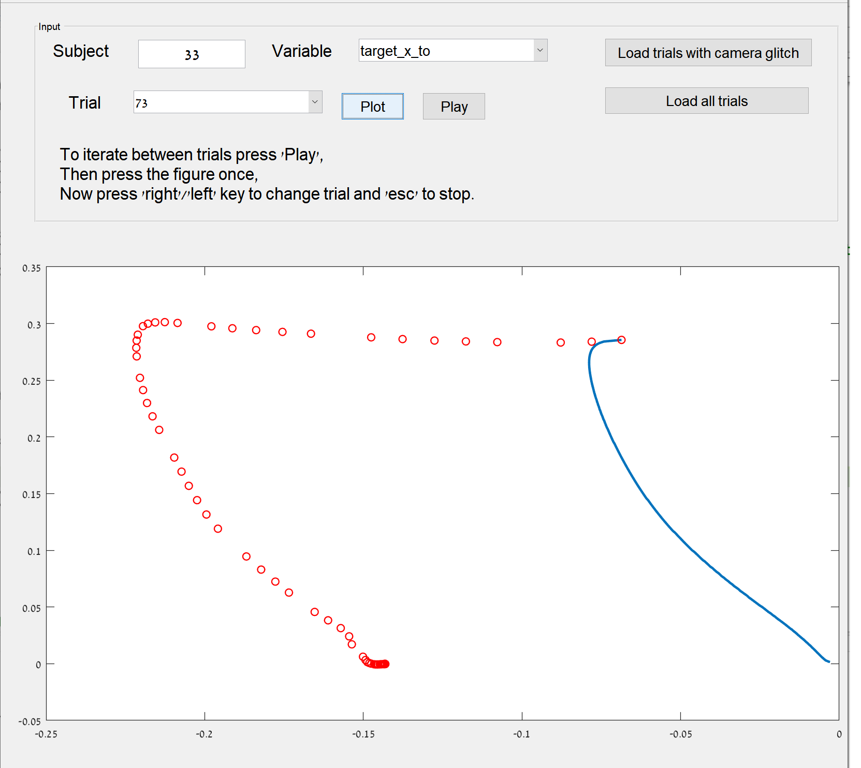
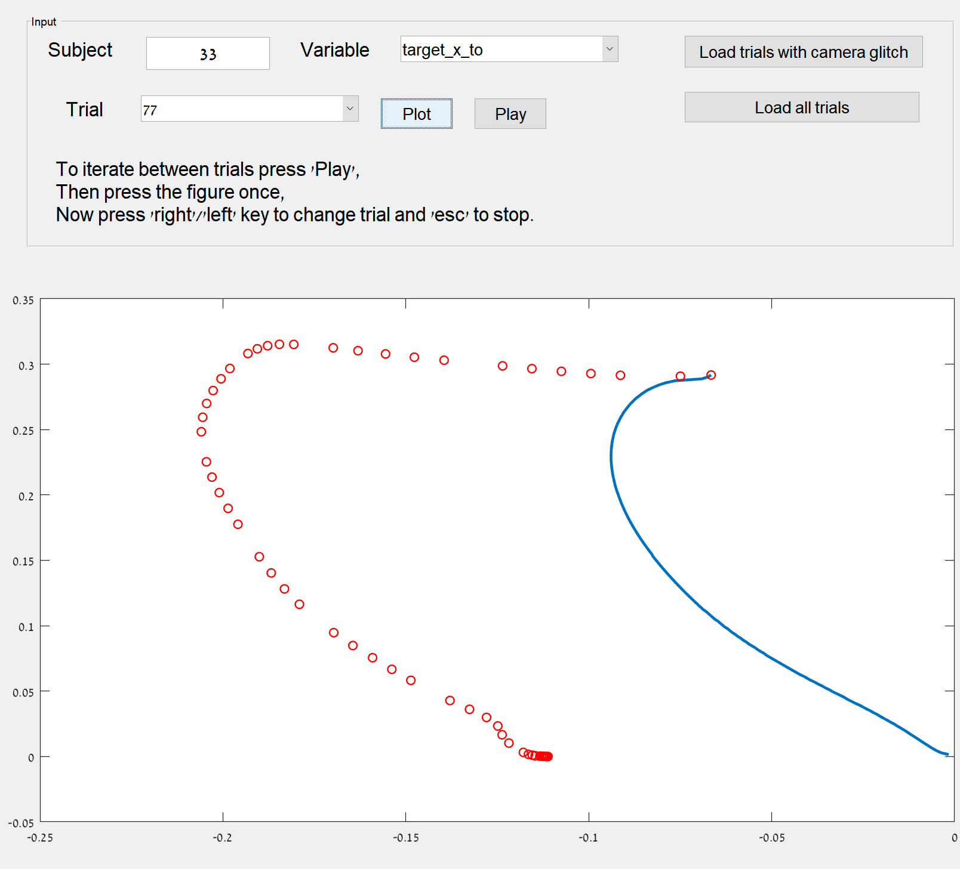
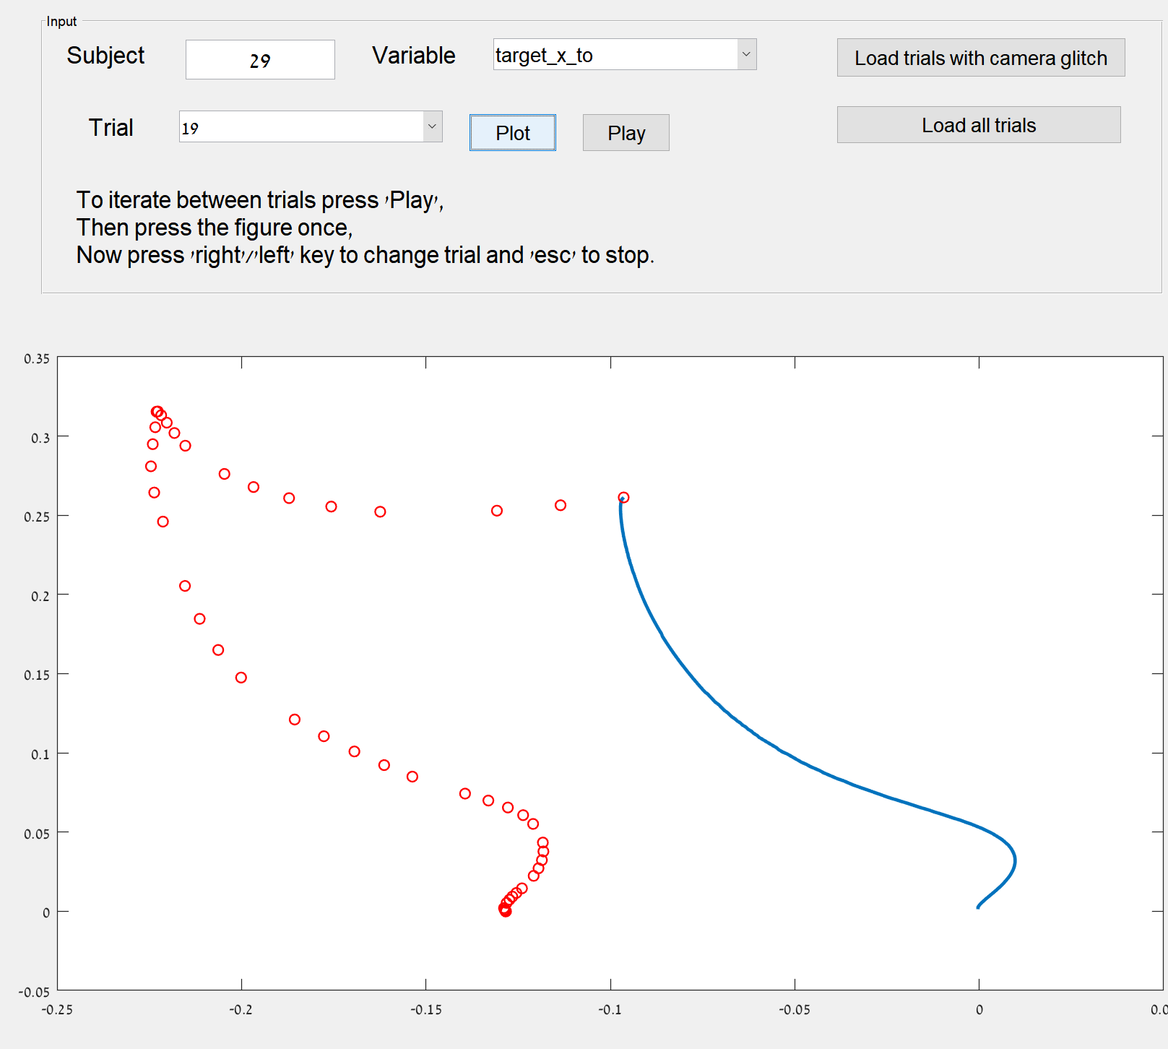
Changes of mind
Some changes of mind are discarded due to “slow movement”.

Slide 12
Changes of mind.
How many COM trials do we have?
Look at your trajs and see what kind of criterion can apply.
Couldn’t find anything concise. They COM can happen on either half of the space (left / right) and can be early or late. You can have more than a single change of mind.
One prominent feature is the “point of maximum” (where the derivative is 0). This is how I recognize them when I look at the trials.

Slide 13
Normalization of Z means that the plots do not represent the actual trajectory.

